Slide 1
Modular Arithmetic

Slide 2
Modular Arithmetic
Central mathematical concept in cryptography.
It is an arithmetic for integers that focus on the reminder.
Wrap around after reaching a certain value called modulus.
Definition: “If a is an integer and n is a positive integer, we define a mod n is the remainder when a is divided by n”. The integer n is called the modulus.

Slide 3

Modulus with an analogy
Clock analogy

Slide 4
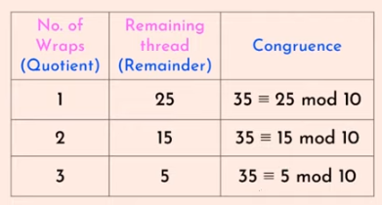
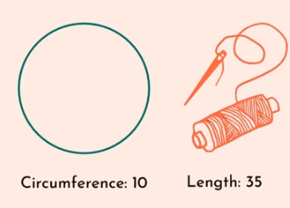
Modulus with an analogy

Slide 5
Properties of Modular Arithmetic
[(a mod n) + (b mod n)] mod n = (a + b) mod n.
[(a mod n) - (b mod n)] mod n = (a - b) mod n.
[(a mod n) x (b mod n)] mod n = (a x b) mod n.

Slide 6
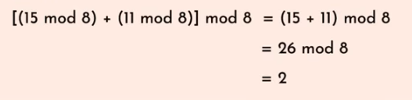
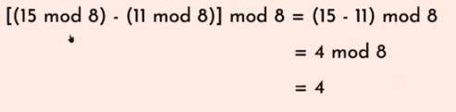
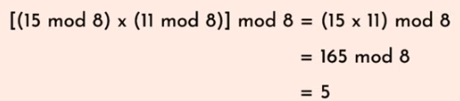
Example

Slide 7
Properties of Modular Arithmetic
Property | Expression
Commutative laws | (a + b) mod n = (b + a) mod n (a x b) mod n = (b x a) mod n
Associative laws | [(a + b) + c] mod n = [a + (b + c)] mod n [(a x b) x c] mod n = [a x (b x c)] mod n
Distributive law | [a x (b + c)] mod n = [(a x b) + (a x c)] mod n
Identities | (0 + a) mod n = a mod n (1 x a) mod n = a mod n
Additive inverse | For each a ∈ Zn, there exists a ‘-a’ such that a + (-a) ≡ 0 mod n Then there exist an additive inverse

Slide 8
Exercise
18 mod 12
24 mod 12
32 mod 12
4 mod 12
8 mod 12

Slide 9
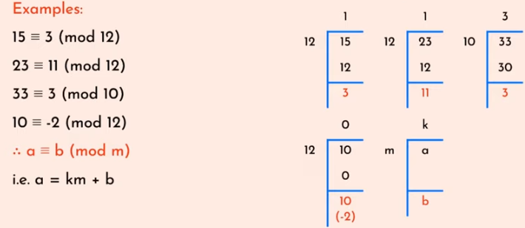
Congruence
In cryptography, congruence (≡) instead of equality (=).

Slide 10
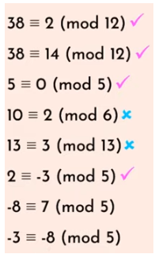
Valid or invalid ?

Slide 11
Congruence
Two integers are congruent modulo m iff they have the same remainder when divided by m
If a and b are integers and n > 0, we write
a ≡ b mod n to mean n|(a − b)
a ≡ b mod n read as a is congruent to b modulo n
a ≡ b mod n means a mod n = b mod n

Slide 12
Properties of Congruence
Congruence have the following properties:
a ≡ r (mod n) if r is the remainder obtained by dividing a by n.
a ≡ a (mod n) – reflexivity
a ≡ b (mod n) implies b ≡ a (mod n) - Symmetry
a ≡ b (mod n) and b ≡ c (mod n) imply
a ≡ c (mod n). - Transitivity

Slide 13
Addition by a Constant
Addition
If a ≡ b (mod n) and c ≠ 0 then
a+c ≡ b+c (mod n)
a-c ≡ a-c (mod n)
a+c ≡ b+c (mod n+c) is not valid

Slide 14
Multiplication by a constant
Multiplication by a Constant
If a ≡ b (mod n) and c ≠ 0 then
ac ≡ bc (mod n)
ac ≡ bc (mod nc) is valid

Slide 15
Points to remember
N mod M = Remainder.
If N is less than M then N mod M = N.
For negative numbers consider anti-clockwise direction.

Slide 16
Modulo of a Negative Number

Slide 17
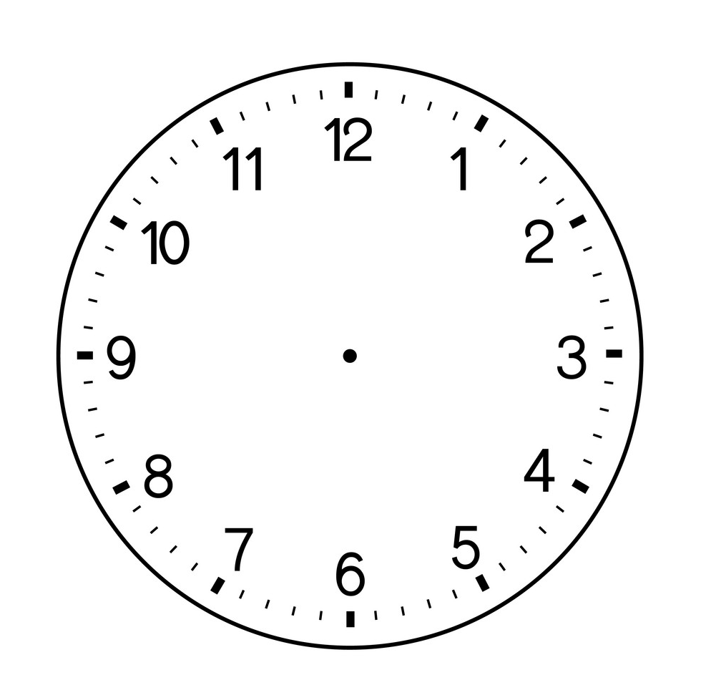
Lets find the Answer
3 mod 12?
7 mod 12?
13 mod 12?

Slide 18
Lets find the Answer
-3 mod 12?
-7 mod 12?
-13 mod 12?
-3 mod 20?
Notes:
9
5
11

Slide 19
How to Calculate ?
-n mod k = k – (n mod k)
-3 mod 12?
-7 mod 12?
-13 mod 12?
-3 mod 20?

